Slide 1
2021 Utility summit Recap & Utility Section Updates
2022 utility summit - February 22, 2022

Slide 2
Excellence in transportation
Every Trip
Every Mode
Every Dollar
Everyone

Slide 3
Notes:
Poll Title: Do not modify the notes in this section to avoid tampering with the Poll Everywhere activity. More info at polleverywhere.com/support Did you enjoy the 2021 Utility Summit? https://www.polleverywhere.com/multiple_choice_polls/91VDDAG92yElntK0T9Cxq?display_state=chart&activity_state=opened&state=opened&flow=Engagement&onscreen=persist

Slide 4
Notes:
Poll Title: Do not modify the notes in this section to avoid tampering with the Poll Everywhere activity. More info at polleverywhere.com/support Did I wear my mask during one of the presentations? https://www.polleverywhere.com/multiple_choice_polls/yMBQBHvCkGa9yJ7Yz97KM?display_state=chart&activity_state=opened&state=opened&flow=Default&onscreen=persist

Slide 5
Notes:
Poll Title: Do not modify the notes in this section to avoid tampering with the Poll Everywhere activity. More info at polleverywhere.com/support Estimate how many total attendees there were at last year's summit. https://www.polleverywhere.com/free_text_polls/YctovbK60A1pEIOW6cXJS

Slide 6
2021 Summit recap
Held Virtually
Attendance: 217
Program Forecast & Policy Update
Provided general overview of DelDOT’s 2021 program.
I-95 & 10th Street Utility Crossing Project
Lessons Learned from DelDOT Projects
Touched on maintenance and highway projects.
Had specific presentations on Claymont Regional & Elkton Rd.
South District Public Works Top 4 Issues from 2020
Notes:
Some of the previous survey questions:
Would additional reimb expedite relocations?
Would funding design consultants expedite responses and relocations?
Would funding work crews at utility companies expedite relocations?
Could DelDOT perform utility work under highway contracts?
Would an incentive/disincentive approach based on performance be attractive?

Slide 7
Updates Overview
Utility Manual Revisions
Blanket Vertical Adjustment Agreements
Utility Cost Estimates & Schedules
FHWA Broadband Rule

Slide 8
Utility Manual Revisions
There are a few high-level topics we will be discussing through the Utilities Coordination Council
Those conversations will shape the update timeline
Follow-up with Internal and External Stakeholders to follow

Slide 9
Blanket Vertical Adjustment Agreements
DelDOT created an internal policy to allow highway contractor to perform at-grade vertical adjustments of utility facilities at DelDOT’s cost (see DGM 3-1) for efficiency purposes
Use at DELDOT’s Discretion
Working to put blanket agreements in place to allow DelDOT to perform vertical adjustments without the need for project specific utility agreements
Currently in place or working to get in place with entities we perform work like this with regularly
DPL-Gas, VZ, Artesian, Tidewater, SUEZ, New Castle County, Kent County, Sussex County, & Wilmington

Slide 10
Utility Cost Estimates - Requirements
FHWA’s Program Guide on Utility Relocation & Accommodation on Federal-Aid Highway Projects outlines requirements of utility cost estimates
https://www.fhwa.dot.gov/reports/utilguid/if03014.pdf
Document generated based the Code of Federal Regulations (CFR)
Utility Agreement requirements are outlined in 23 CFR § 645.113. This includes discussion on cost estimates.
Utility Cost Development & Reimbursement requirements are outlined in 23 CFR § 645.117
Working to bring estimates into compliance

Slide 11
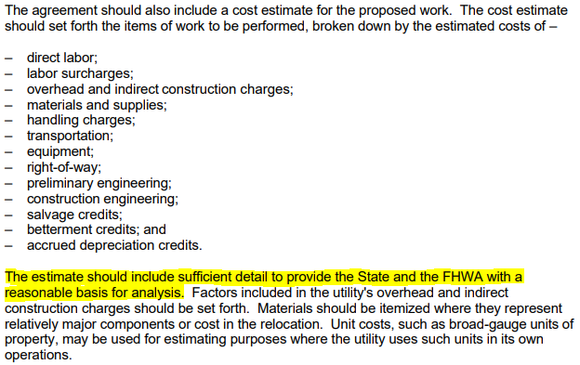
Utility Cost Estimates - Requirements
23 CFR § 645.113

Slide 12
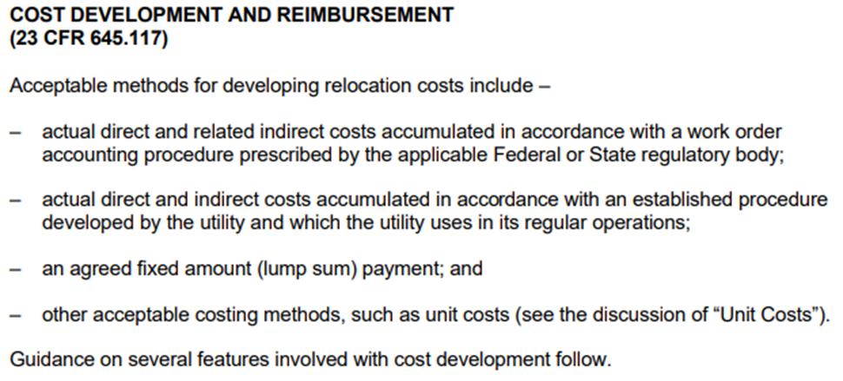
Utility Cost Estimates - Requirements
23 CFR § 645.117

Slide 13
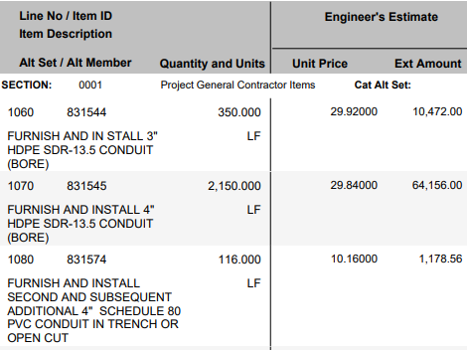
Utility Cost Estimates – Immediate Needs
Estimates should provide enough detail for DelDOT to verify costs accurate to reimbursable work that is allowed based on project coordination
Need to include unit costs & quantities based on plans and coordination

Slide 14
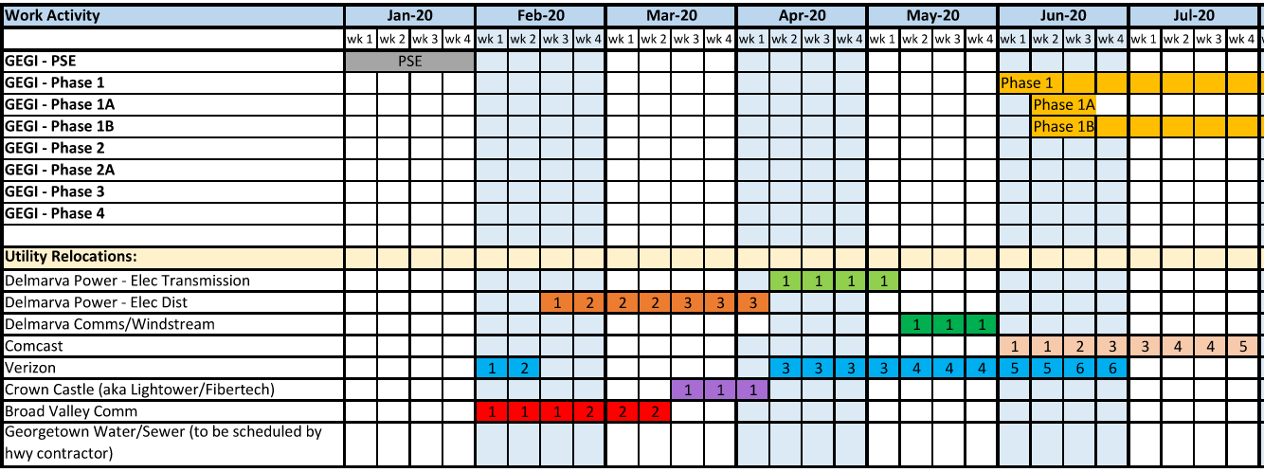
Relocation Schedules (Bar Charts)
Working to improve utility relocation schedules
Need to show DelDOT anticipated milestones
Need to show utility relocation timing and durations based on activities.

Slide 15
Notes:
Poll Title: Do not modify the notes in this section to avoid tampering with the Poll Everywhere activity. More info at polleverywhere.com/support Which broadband providers are participating today? https://www.polleverywhere.com/free_text_polls/059nkvNeOxwO5BFrxAh1V

Slide 16
FHWA Broadband Rule
The Broadband Infrastructure Deployment final rule to 23 CFR 645 was published on December 3, 2021
Direct link: https://www.federalregister.gov/documents/2021/12/03/2021-26231/broadband-infrastructure-deployment
Aims to facilitate the installation of broadband infrastructure
Requires that States meet specific registration, notification, and coordination requirements to facilitate broadband infrastructure deployment in the ROW of applicable Federal-aid highway projects

Slide 17
FHWA Broadband Rule - Requirements
Identify a broadband utility coordinator who is responsible for facilitating the infrastructure ROW efforts within the State
Create a registration process for broadband infrastructure entities that seek to be included
Establish a process for electronically notifying broadband infrastructure entities annually of the State Transportation Improvement Program (STIP)
Coordinate initiatives under Section 607 of the MOBILE NOW Act with other statewide telecommunication and broadband plans and State and local transportation and land use plans, including strategies to minimize repeated excavations that involve broadband infrastructure installation in a ROW

Slide 18
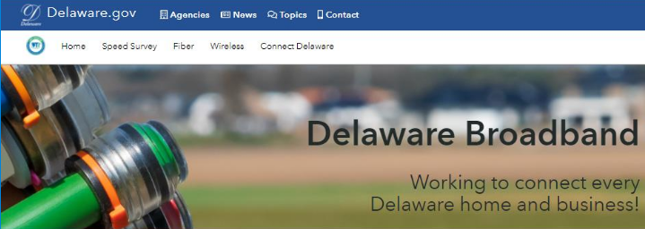
FHWA Broadband Rule
Actively working to meet these requirements
Creating a webpage with online registration system
Anticipate will be live by FHWA’s March 3, 2022 deadline

Slide 19
Notes:
Poll Title: Do not modify the notes in this section to avoid tampering with the Poll Everywhere activity. More info at polleverywhere.com/support Where can information be found regarding DelDOT policy behind blanket vertical adjustment agreeemnts? https://www.polleverywhere.com/multiple_choice_polls/ZPdA1bsWqIlflOZYlEkSd?display_state=chart&activity_state=opened&state=opened&flow=Engagement&onscreen=persist

Slide 20
Notes:
Poll Title: Do not modify the notes in this section to avoid tampering with the Poll Everywhere activity. More info at polleverywhere.com/support Where should I go to find more information related to utility cost estimate requirements? https://www.polleverywhere.com/multiple_choice_polls/vaC4BNSzbM5daUjdN9bwY?display_state=chart&activity_state=opened&state=opened&flow=Default&onscreen=persist

Slide 21
Thank you
Eric Cimo, P.E., DelDOT Utility Engineer
eric.cimo@delaware.gov, 302 760-2642

